Slide 1
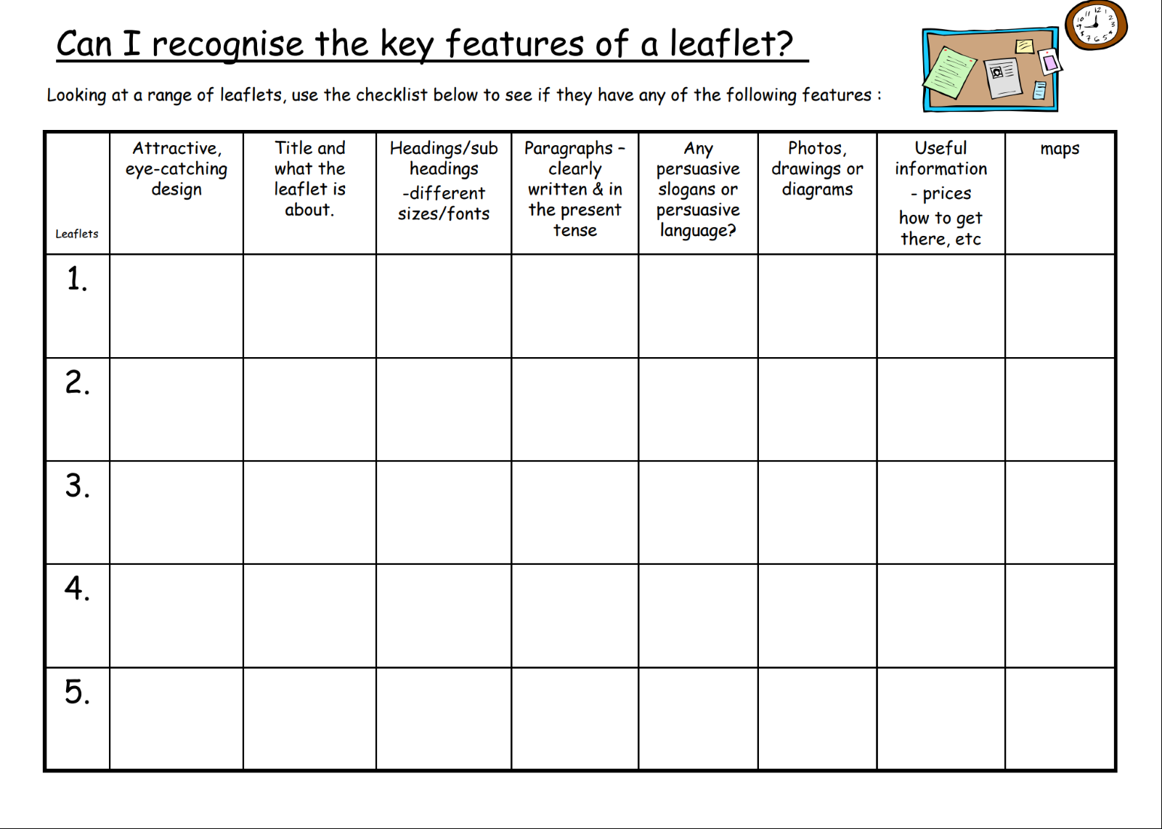
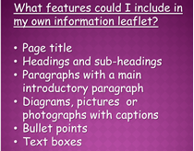
LO: Identify features of an information leaflet
Watch video:
https://www.bbc.co.uk/bitesize/topics/zgqxwnb/articles/zrjqpg8
Look at a variety of different leaflets online. Look at the leaflets and complete the table below. The sheet will allow up to 5 leaflets to be completed.

Slide 2
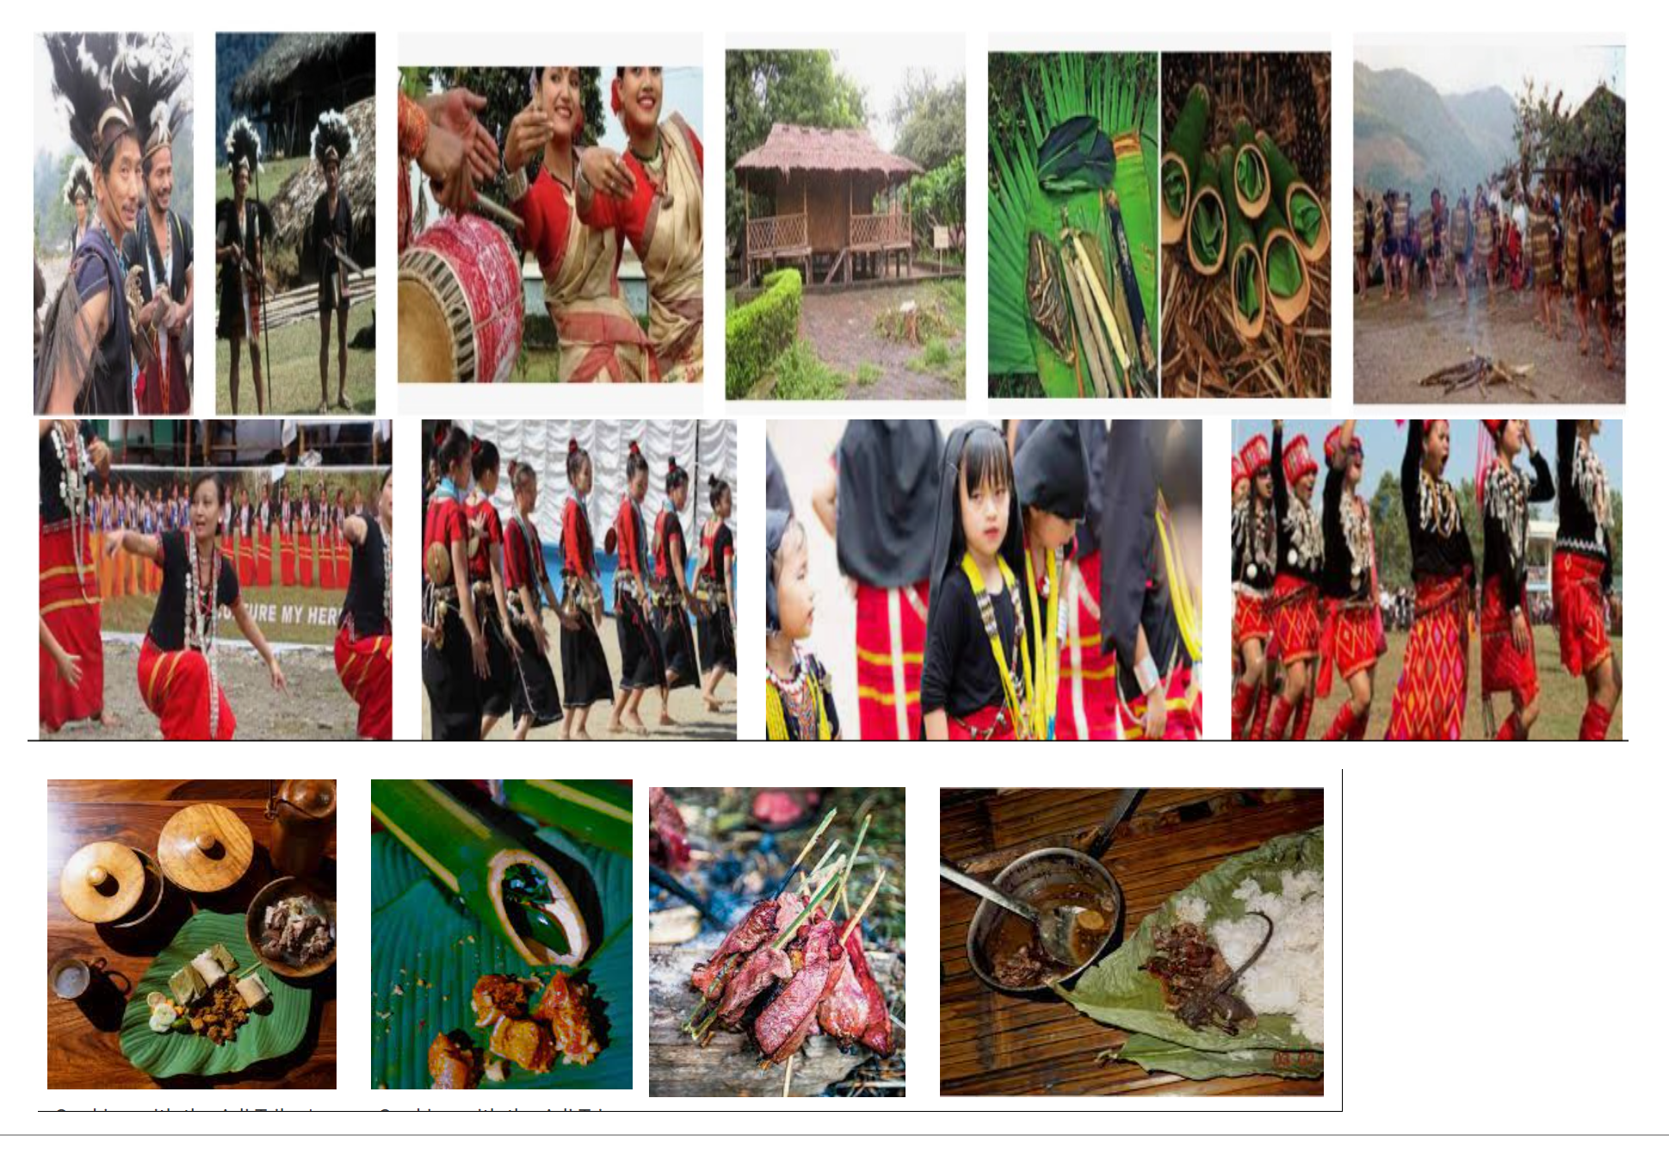
LO: Use varied and rich vocabulary
Look at images of the Adi (also known as Lhoba people), the Himalayan hill tribe. Use the pictures to discuss and make notes on what you see and how you think the Adi live. Look for clues in the pictures about homes they live in, what they eat and how they survive in the hostile climate and terrain of the Himalayas.
Make a list of adjectives and words that can be used to describe what you can see in the pictures.
What do you see?
How do you think these people will live?
What do they eat?
What do you think the weather is like?
^^^ include 2A’s here.
Then, spend the remaining time watching videos about the Adi tribe to learn as much information as possible about them.
I’ve checked and there are quite a few videos on Youtube.

Slide 3
LO: Organise ideas around a theme
The next three days are going to be researching the Adi tribe to gain as much information as possible to create an information leaflet.
We still want to see expanded noun phrases and fronted adverbials today!
Use the different sources of information that you have seen, photographs, videos and sheets of information from the BBC.
Locate on maps where they live and draw a map into your book.
Lifestyle
Where do they live?
What do they eat?
What food do they grow?
What animals do they hunt?
Find interesting facts to create a ‘Did you know box’.

Slide 4
LO: Use the present tense
We still want to see expanded noun phrases and fronted adverbials today!
Find out about the beliefs of the Adi including any festivals and celebrations they have. Discuss why their beliefs appear so different from our own and how they have managed to remain so isolated from modern civilisation. Use a variety of source materials to collect this information under the heading ‘Festivals and celebrations’.
Festivals and celebrations
What festivals do they have?
How do they celebrate?
How do their beliefs compare to ours?
How are they so isolated?
Use the BBC sheet to help support this and draw on the knowledge from the pictures and videos from earlier on in the week.
Add in some drawings to support.

Slide 5
LO: Organise ideas into a logical sequence
Today is the final day of research.
Consider the future for the Adi Tribe.
How are things changing for them?
Create this paragraph of information and then use the rest of the session to ensure that all the research has been completed in all areas, including all labelled pictures.

Slide 8
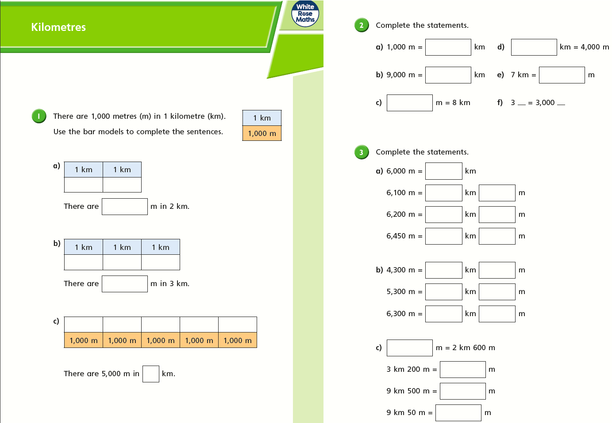

Slide 9
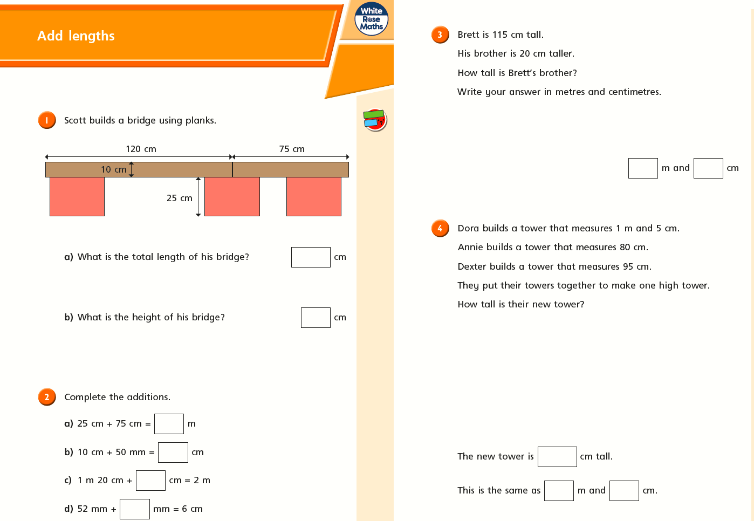

Slide 11
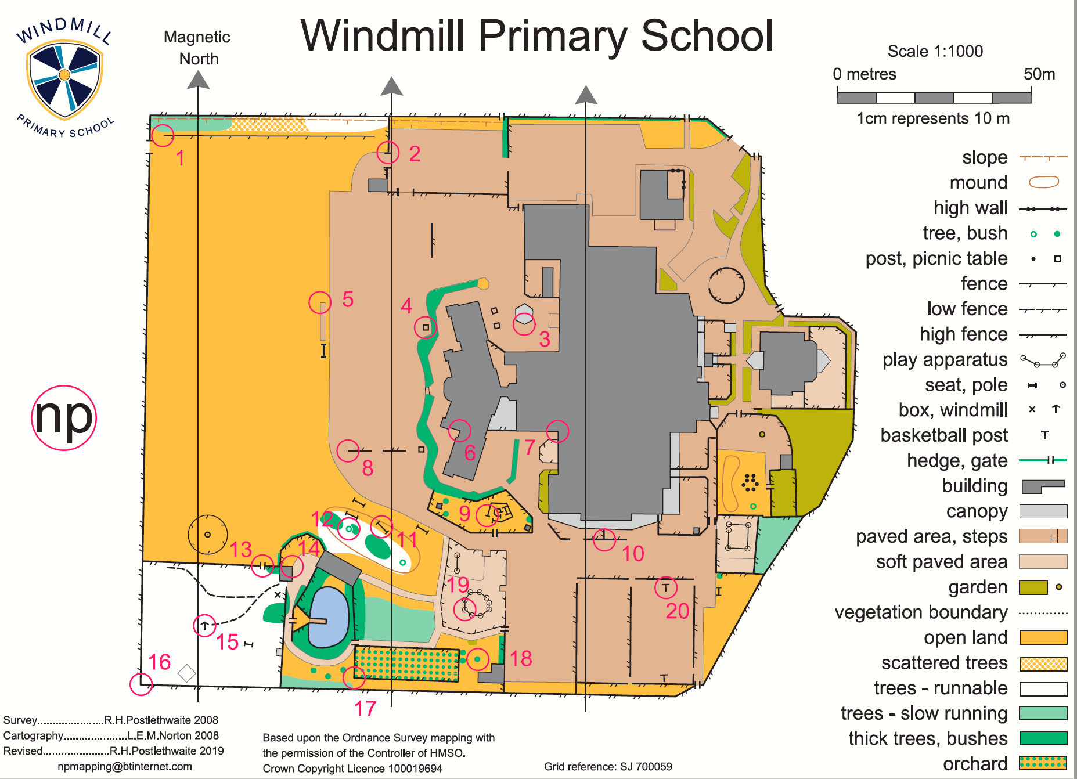
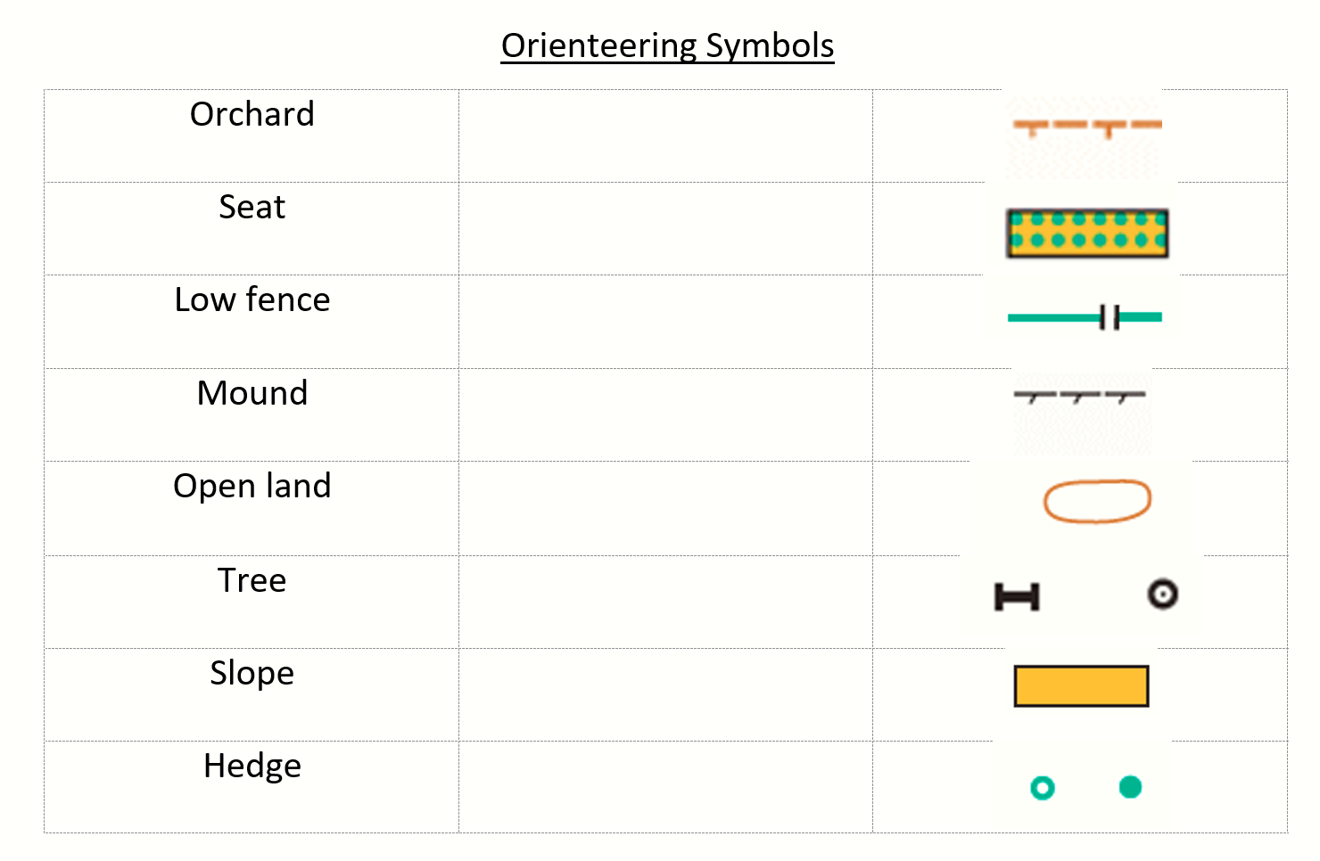

Slide 12
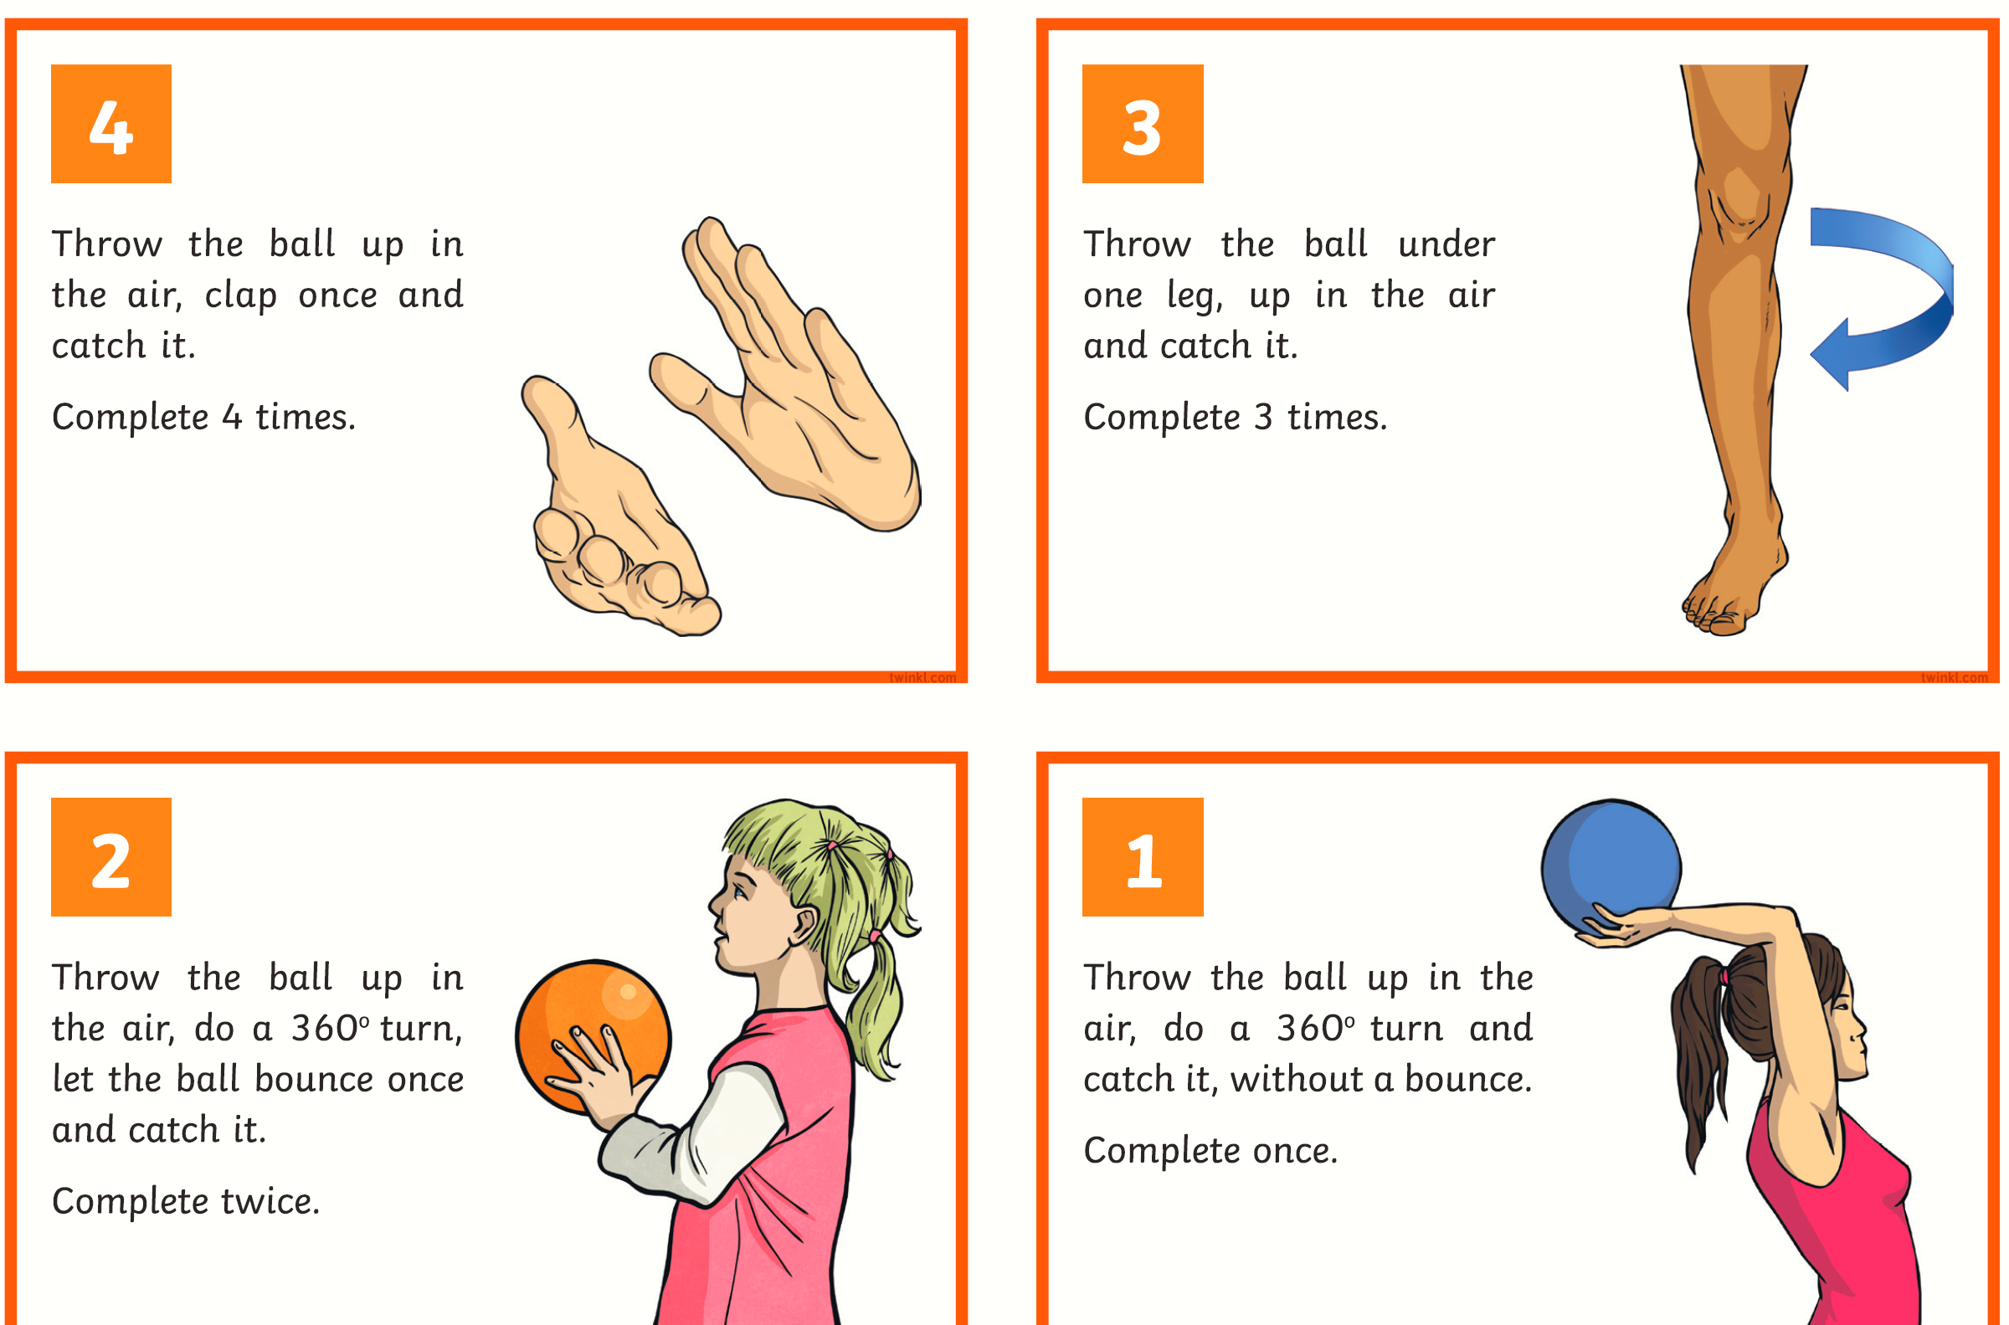

Slide 13
Music: Login with the details you previously received via message. Simply follow the link, login and complete the assignment. https://www.telfordwrekinmusiconline.co.uk/yumu

Slide 14
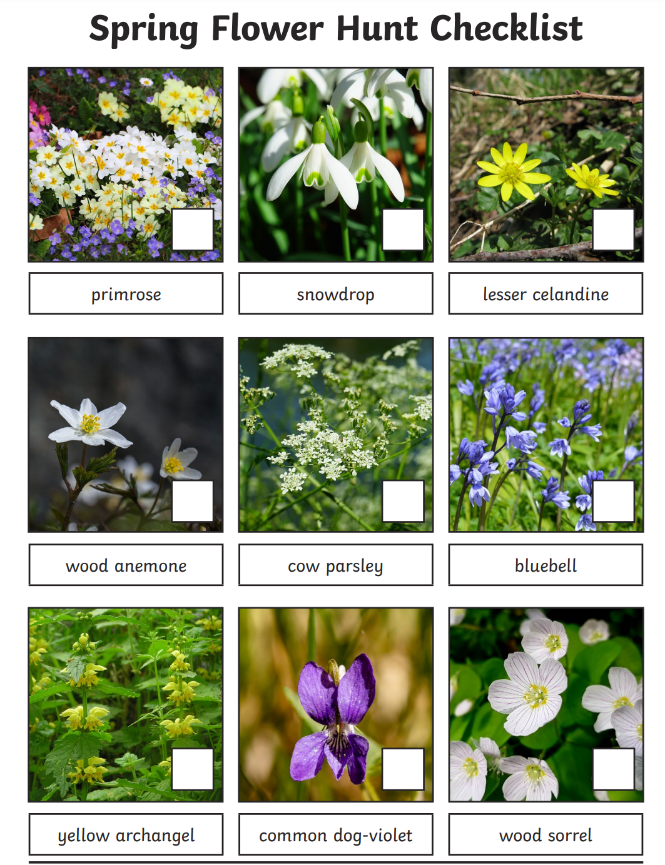
LO: Identify and name a variety of plants in the local environment and a contrasting environment from their physical appearance Create a checklist in books – (run through colour, shape, feel, smell and texture – what do these things tell us) Colour – pollinator or camouflage, evergreen or seasonally affected Feel – defending itself from predators, good for habitat or useful for wildlife etc. Smell – attract / deter people / wildlife Texture – good to absorb rain or light etc. Go on a flower hunt.

Slide 15
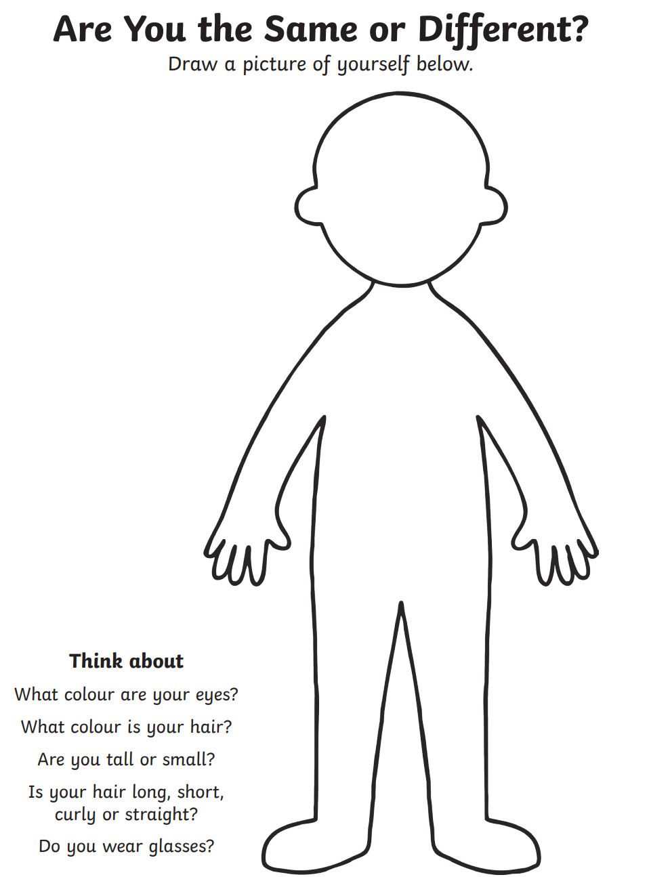
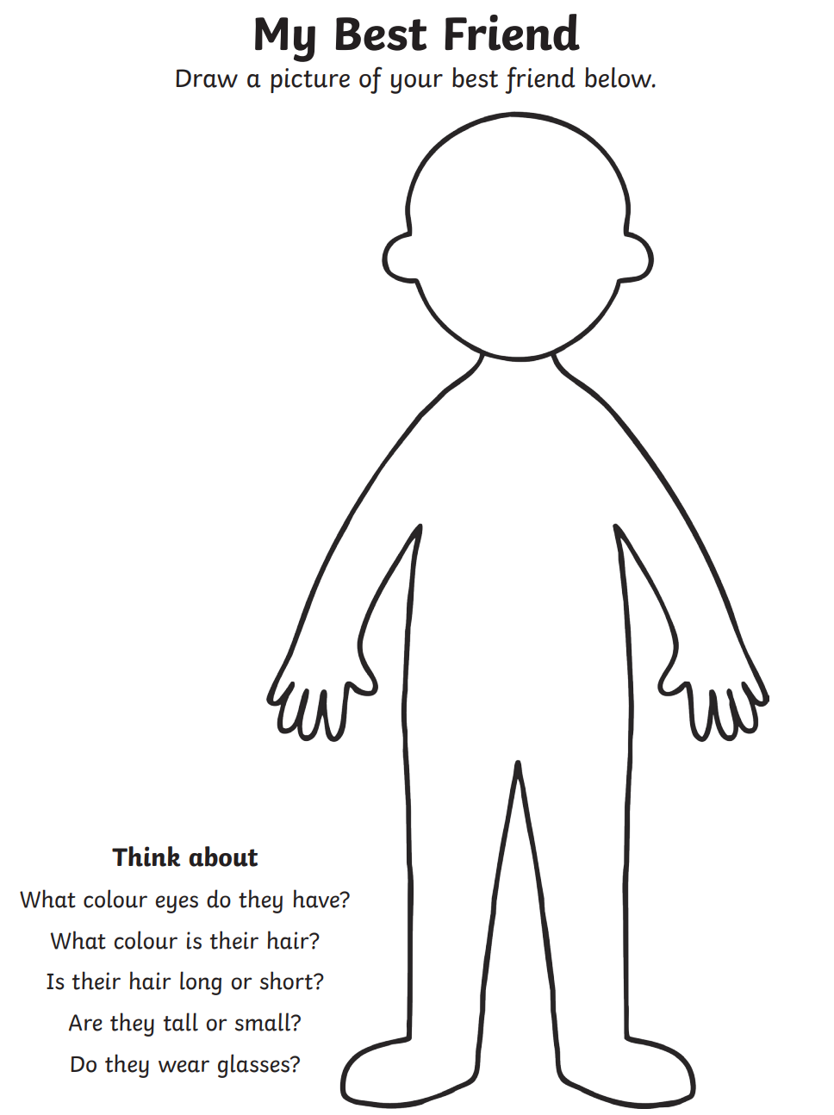
LO: To understand more about racism

